Slide 1
Big data analytics
Hadoop architecture
Mr Ngosa Gathams

Slide 2
5Vs” of Big Data
Volume: With increasing dependence on technology, data is producing at a large volume. Common examples are data being produced by various social networking sites, sensors, scanners, airlines and other organizations.
Velocity: Huge amount of data is generated per second. It is estimated that by the end of 2020, every individual will produce 3mb data per second. This large volume of data is being generated with a great velocity.
Variety: The data being produced by different means is of three types:
Structured Data: It is the relational data which is stored in the form of rows and columns.
Unstructured Data: Texts, pictures, videos etc. are the examples of unstructured data which can’t be stored in the form of rows and columns.
Semi Structured Data: Log files are the examples of this type of data.

Slide 3
5Vs” of Big Data
Veracity: The term Veracity is coined for the inconsistent or incomplete data which results in the generation of doubtful or uncertain Information. Often data inconsistency arises because of the volume or amount of data e.g. data in bulk could create confusion whereas less amount of data could convey half or incomplete Information.
Value: After having the 4 V’s into account there comes one more V which stands for Value!. Bulk of Data having no Value is of no good to the company, unless you turn it into something useful. Data in itself is of no use or importance but it needs to be converted into something valuable to extract Information. Hence, you can state that Value! is the most important V of all the 5V’s

Slide 4
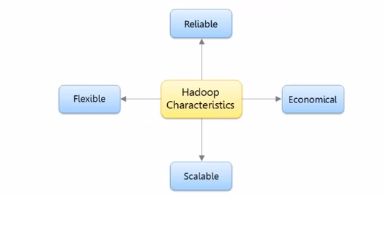
What is Hadoop ?
Apache Hadoop is a framework that allows the distributed processing of large data sets across clusters of commodity computers using a simple programming model.
It is an open-source data management technology with scale-out storage and distributed processing.

Slide 5


What is Hadoop?
A scalable fault-tolerant distributed system for data storage and processing
Core Hadoop has two main components
Hadoop Distributed File System (HDFS): self-healing, high- bandwidth clustered storage
Reliable, redundant, distributed file system optimized for large files
MapReduce: fault-tolerant distributed processing
Programming model for processing sets of data
Mapping inputs to outputs and reducing the output of multiple Mappers to one (or a few) answer(s)
Operates on unstructured and structured data A large and active ecosystem
Open source under the friendly Apache License
http://wiki.apache.org/hadoop/

Slide 6
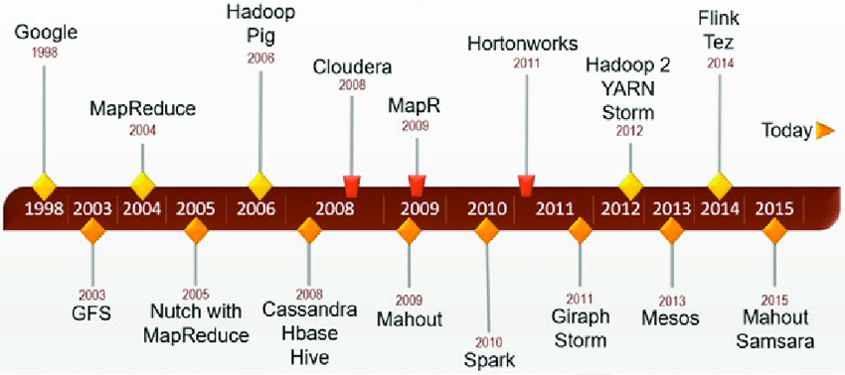
Evolution of Hadoop

Slide 7





































Hadoop Adoption in the Industry
2007
2008
2009
2010
The Datagraph Blog
Source: Hadoop Summit Presentations
Introduction to Analytics and Big Data - Hadoop
© 2014 Storage Networking Industry Association. All Rights Reserved.

Slide 8
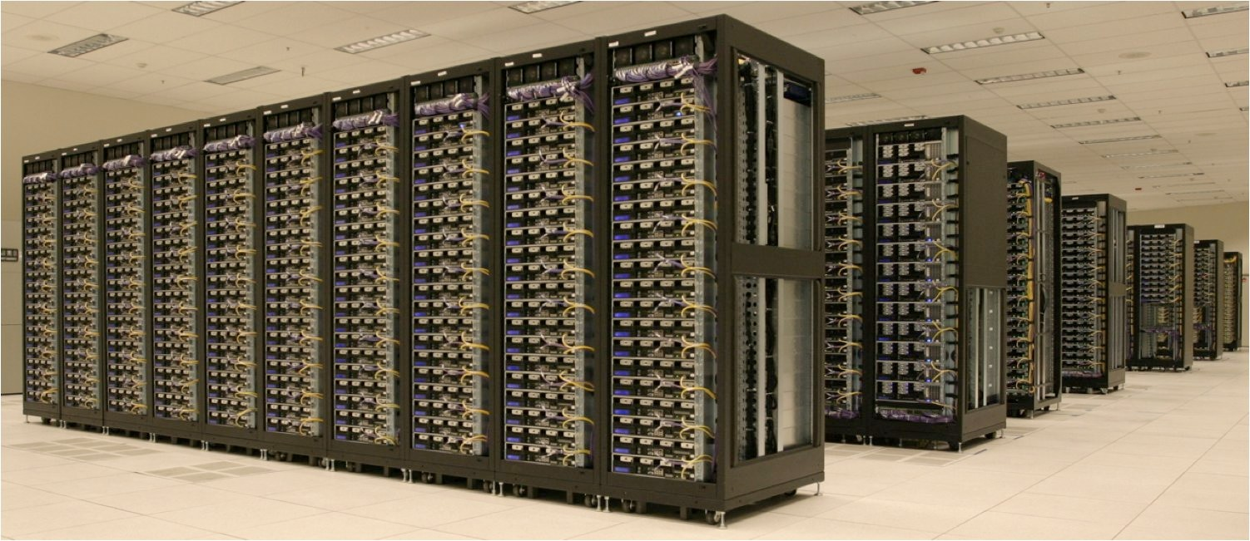

Hadoop At Yahoo!
25,000 +machines in10+ clusters
Largest cluster is 3,000machines
3Petabytes of data (compressed, unreplicated)
700+ users
10,000+ jobs/week

Slide 9
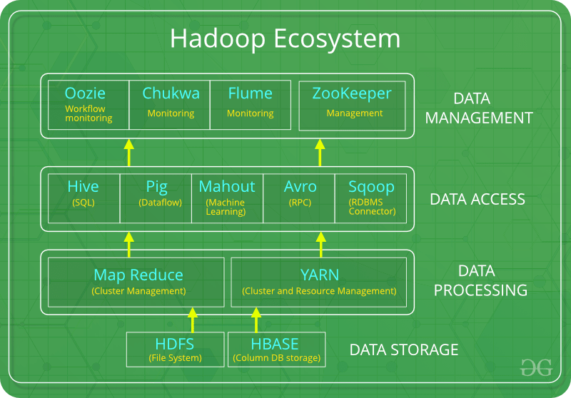

Slide 10
Hadoop ecosystem
HDFS: Hadoop Distributed File System
YARN: Yet Another Resource Negotiator
MapReduce: Programming based Data Processing
Spark: In-Memory data processing
PIG, HIVE: Query based processing of data services
HBase: NoSQL Database
Mahout, Spark MLLib: Machine Learning algorithm libraries
Solar, Lucene: Searching and Indexing
Zookeeper: Managing cluster
Oozie: Job Scheduling

Slide 12
HDFS:
HDFS is the primary or major component of Hadoop ecosystem and is responsible for storing large data sets of structured or unstructured data across various nodes and thereby maintaining the metadata in the form of log files.
HDFS consists of two core components i.e.
Name node
Data Node
Name Node is the prime node which contains metadata (data about data) requiring comparatively fewer resources than the data nodes that stores the actual data. These data nodes are commodity hardware in the distributed environment. Undoubtedly, making Hadoop cost effective.
HDFS maintains all the coordination between the clusters and hardware, thus working at the heart of the system.

Slide 13
Apache HBase
It’s a NoSQL database which supports all kinds of data and thus capable of handling anything of Hadoop Database. It provides capabilities of Google’s BigTable, thus able to work on Big Data sets effectively.
At times where we need to search or retrieve the occurrences of something small in a huge database, the request must be processed within a short quick span of time. At such times, HBase comes handy as it gives us a tolerant way of storing limited data

Slide 15
YARN
Yet Another Resource Negotiator, as the name implies, YARN is the one who helps to manage the resources across the clusters. In short, it performs scheduling and resource allocation for the Hadoop System.
Consists of three major components i.e.
Resource Manager
Nodes Manager
Application Manager
Resource manager has the privilege of allocating resources for the applications in a system whereas Node managers work on the allocation of resources such as CPU, memory, bandwidth per machine and later on acknowledges the resource manager.
Application manager works as an interface between the resource manager and node manager and performs negotiations as per the requirement of the two.

Slide 16
MapReduce
By making the use of distributed and parallel algorithms, MapReduce makes it possible to carry over the processing’s logic and helps to write applications which transform big data sets into a manageable one.
MapReduce makes the use of two functions i.e. Map() and Reduce() whose task is:
Map() performs sorting and filtering of data and thereby organizing them in the form of group. Map generates a key-value pair based result which is lateron processed by the Reduce() method.
Reduce(), as the name suggests does the summarization by aggregating the mapped data. In simple, Reduce() takes the output generated by Map() as input and combines those tuples into smaller set of tuples.

Slide 18
PIG
Pig was basically developed by Yahoo which works on a pig Latin language, which is Query based language similar to SQL.
It is a platform for structuring the data flow, processing and analyzing huge data sets.
Pig does the work of executing commands and in the background, all the activities of MapReduce are taken care of. After the processing, pig stores the result in HDFS.
Pig Latin language is specially designed for this framework which runs on Pig Runtime. Just the way Java runs on the JVM.
Pig helps to achieve ease of programming and optimization and hence is a major segment of the Hadoop Ecosystem.

Slide 19
HIVE
With the help of SQL methodology and interface, HIVE performs reading and writing of large data sets. However, its query language is called as HQL (Hive Query Language).
It is highly scalable as it allows real-time processing and batch processing both. Also, all the SQL datatypes are supported by Hive thus, making the query processing easier.
Similar to the Query Processing frameworks, HIVE too comes with two components: JDBC Drivers and HIVE Command Line.
JDBC, along with ODBC drivers work on establishing the data storage permissions and connection whereas HIVE Command line helps in the processing of queries.

Slide 20
Mahout
Mahout, allows Machine Learnability to a system or application. Machine Learning, as the name suggests helps the system to develop itself based on some patterns, user/environmental interaction or on the basis of algorithms.
It provides various libraries or functionalities such as collaborative filtering, clustering, and classification which are nothing but concepts of Machine learning. It allows invoking algorithms as per our need with the help of its own libraries.

Slide 21
Apache Spark
It’s a platform that handles all the process consumptive tasks like batch processing, interactive or iterative real-time processing, graph conversions, and visualization, etc.
It consumes in memory resources hence, thus being faster than the prior in terms of optimization.
Spark is best suited for real-time data whereas Hadoop is best suited for structured data or batch processing, hence both are used in most of the companies interchangeably.

Slide 23
Data Management
Solr, Lucene: These are the two services that perform the task of searching and indexing with the help of some java libraries, especially Lucene is based on Java which allows spell check mechanism, as well. However, Lucene is driven by Solr.
Zookeeper: There was a huge issue of management of coordination and synchronization among the resources or the components of Hadoop which resulted in inconsistency, often. Zookeeper overcame all the problems by performing synchronization, inter-component based communication, grouping, and maintenance.
Oozie: Oozie simply performs the task of a scheduler, thus scheduling jobs and binding them together as a single unit. There is two kinds of jobs .i.e Oozie workflow and Oozie coordinator jobs. Oozie workflow is the jobs that need to be executed in a sequentially ordered manner whereas Oozie Coordinator jobs are those that are triggered when some data or external stimulus is given to it.

Slide 24
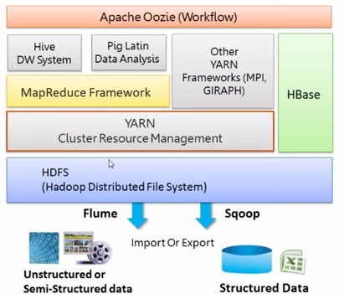
Hadoop Ecosystem

Slide 25
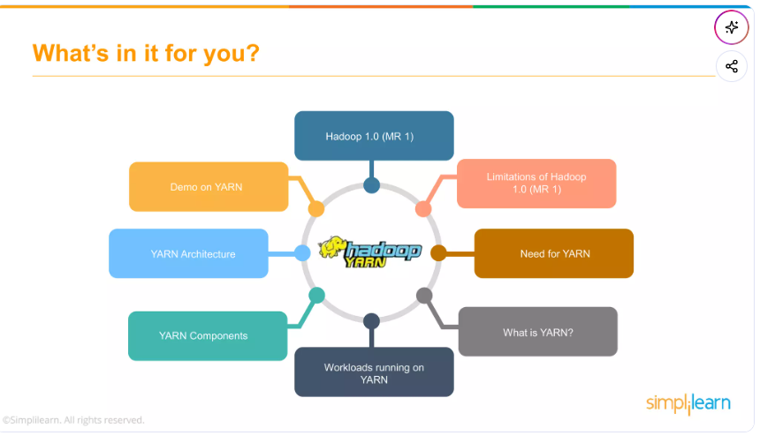

Slide 26
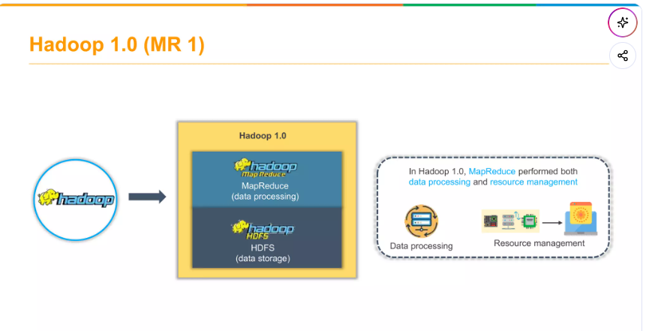

Slide 27
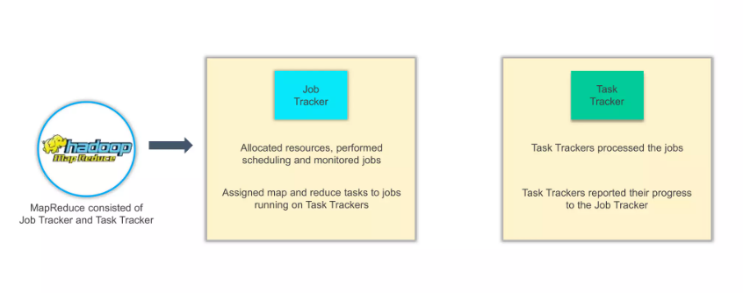

Slide 28
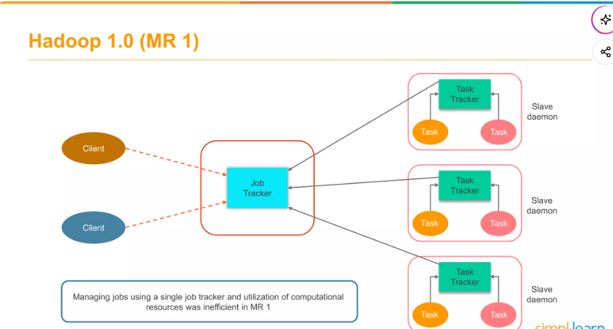

Slide 29
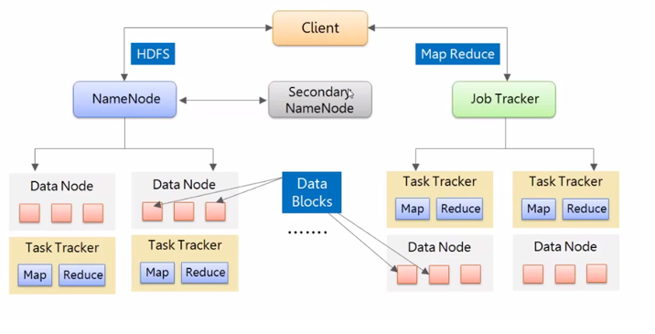
Hadoop 1.x Architecture

Slide 30
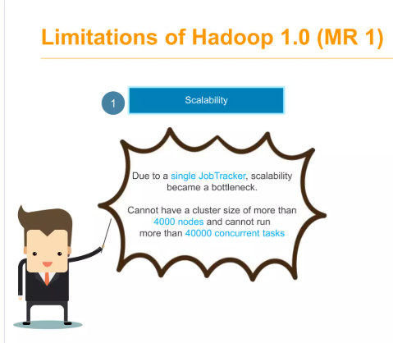
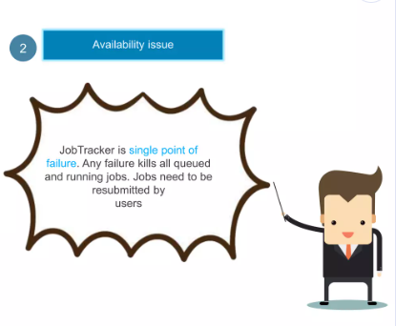
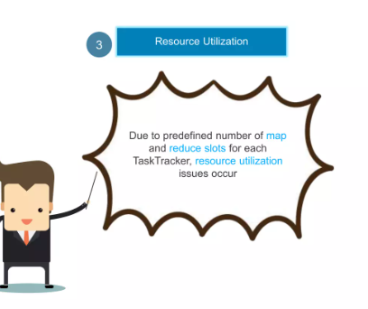
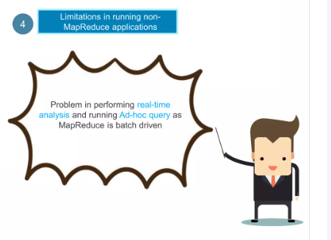

Slide 31
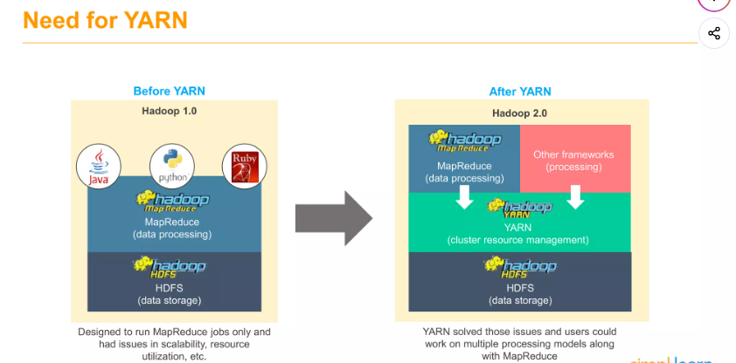

Slide 32
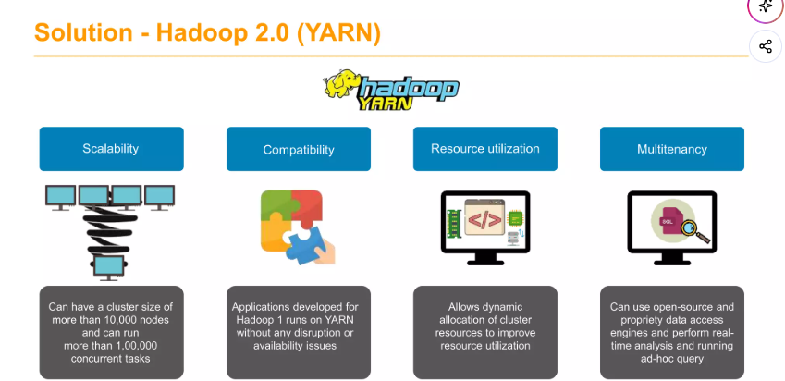

Slide 33
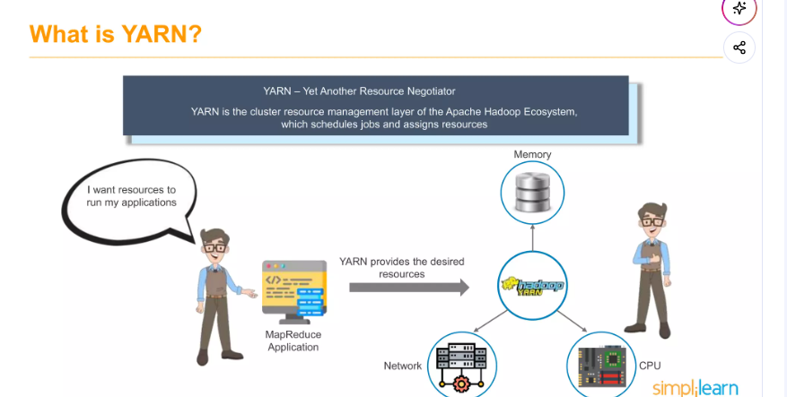

Slide 34
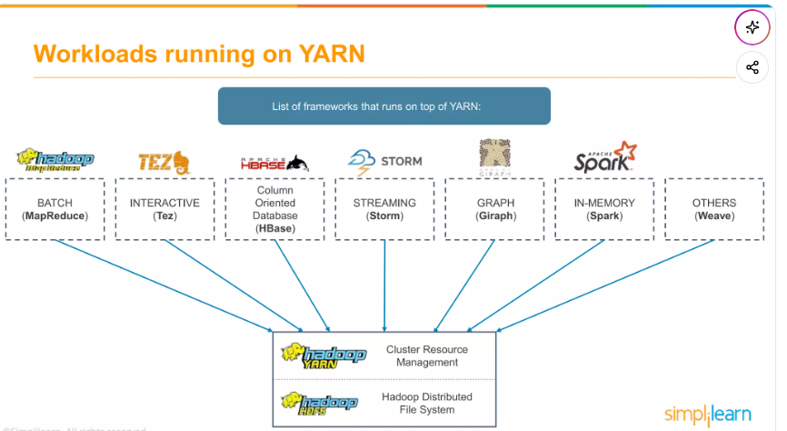

Slide 35
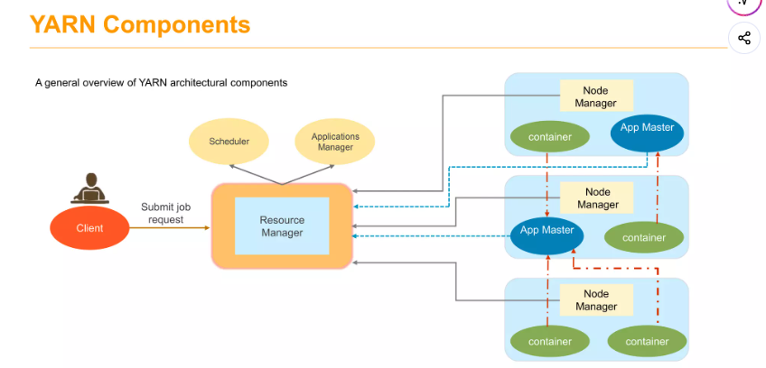

Slide 36
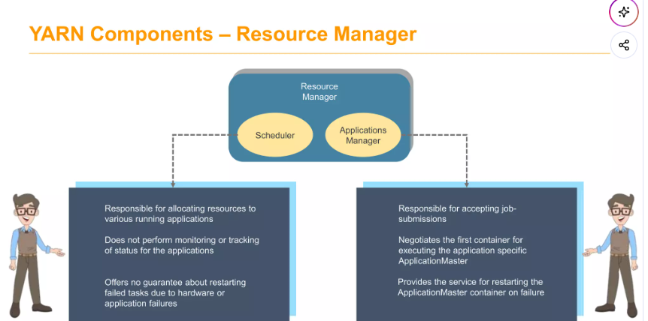

Slide 37
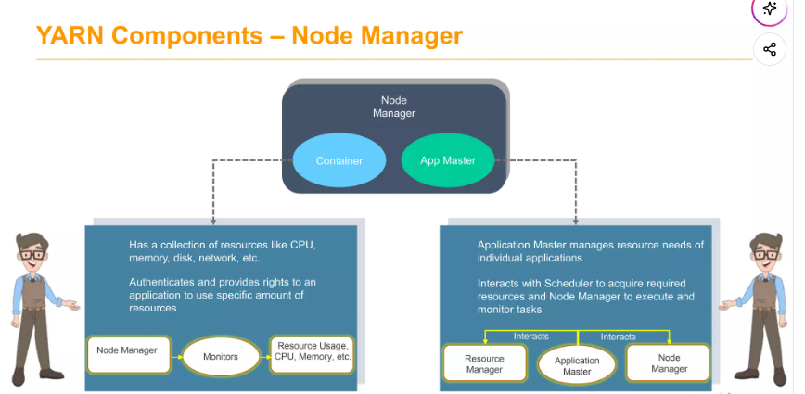

Slide 38
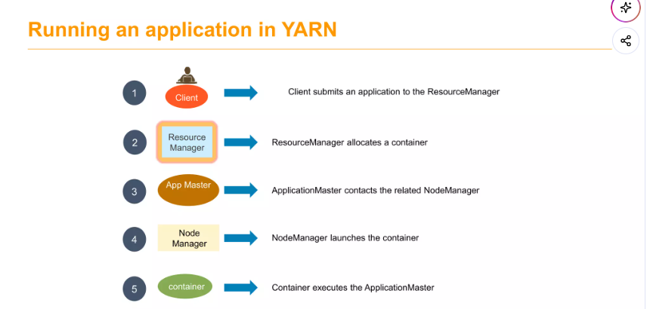

Slide 39
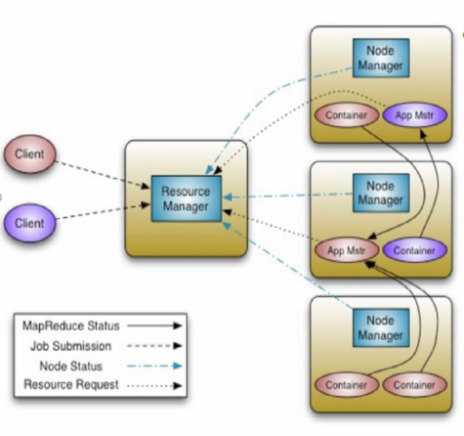
YARN Architectural Overview
Scalability – Clusters of 6000 – 10000 machines
  Each machine with 16 cores , 48GB/96GB RAM, 24TB/36TB Hard Disks.
  100,000 + Concurrent tasks
  10000 concurrent jobs

Slide 40
Scheduling in Yarn
Scheduling is an important task when Hadoop cluster is shared between many users and tasks. Problem is which user’s task should be run first or which task should be run first, big one or small one.
Hadoop 1 which use FIFO scheduler with slot (fixed cpu, memory and disk count) based model was very inefficient for shared clusters, whereas Hadoop 2 introduced Capacity (by Yahoo) and Fair (by Facebook) schedulers with container (dynamic cpu, memory and disk count) allocation model as part of the Yarn, which is more efficient than FIFO scheduler.
Yarn supports three schedulers FIFO, Capacity and Fair schedulers, we’ll consider them in next slide. It also provide opportunity to create your own scheduler by extending Fair scheduler class.

Slide 41
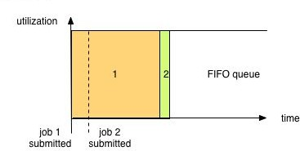
Scheduling in Yarn
FIFO - First Input First Output:
the simplest and most understandable scheduler
It doesn’t needing any configuration.
But it’s not suitable for shared clusters because big applications eat all resources.

Slide 42
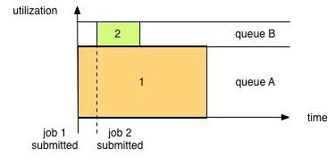
Scheduling in Yarn
Capacity scheduler - allows sharing of a Hadoop cluster along organizational lines (each one is a queue). Queues may be further divided in hierarchical fashion.
each organization is allocated a certain capacity of the overall cluster.
if there is more than one job Capacity Scheduler may allocate the spare resources to jobs in the queue, even if that causes the queue’s capacity to be exceeded. (queue elasticity.)
when demand increases, the queue will only return to capacity as resources are released from other queues as containers complete. If it’s not have configured policy .

Slide 43
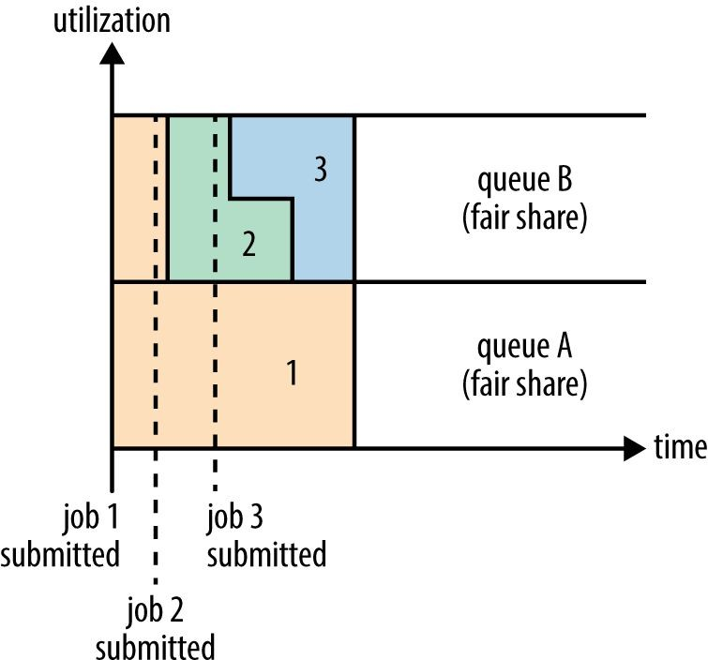
Scheduling in Yarn
Fair Scheduler dynamically balance resources (evenly between all tasks) between all running jobs. There is also queue hierarchy for organisations.
If queue policy is not configured it is Fair (50/50% or 1:1)
Preemption allows the scheduler to kill containers for queues that are running with more than their fair share of resources
Delay scheduling allows allocating container in same node where application was submitted.
Dominant Resource Fairness (drf) gives priority to tasks which have the most dominant resources

Slide 44

Questions

